Slide 1

Infection Prevention
Brenda Dalrymple, BSN, RN,CIC,

Slide 2
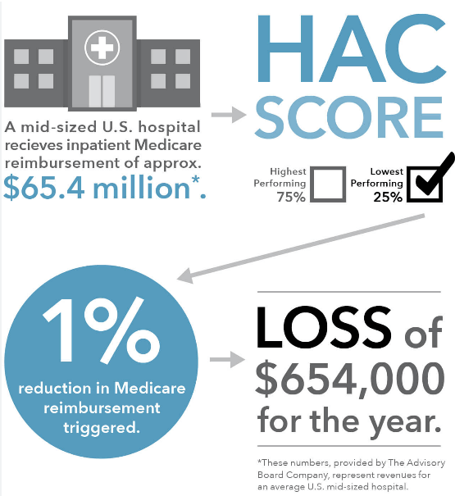
Impact of Healthcare-Associated Infections
Patient Safety
HAIs increase morbidity and mortality
Healthcare Cost
Increased length of stay
Increased cost of treatment
CMS Reimbursement
Value-Based Purchasing Program (2%)
HAC Reduction Program (1%)
Hospital Readmissions Program (2%)

Slide 3
Core Infection prevention and control-standards for safe healthcare delivery
Hand Hygiene
Environmental cleaning and disinfection
Injection and medication safety
Temporary invasive medical devices
Occupational Health
Minimize potential exposures

Slide 4
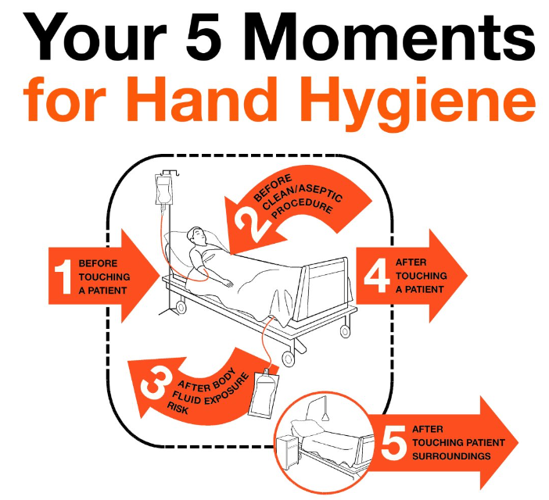
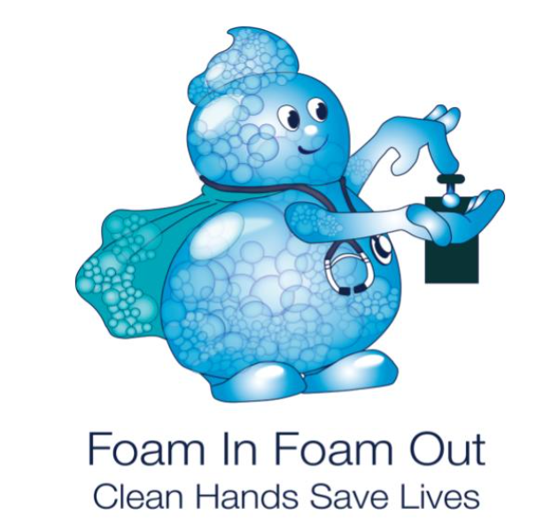
15-20 seconds
(World Health Organization, Save lives, clean your hands)

Slide 5
Mandatory Hospital acquired infection (HAI) reporting for NHSN
C. diff
MRSA bacteremia
Catheter associated urinary tract infection (CAUTI)
Central line associated blood stream infections (CLABSI)
Surgical site infections (SSI)

Slide 6
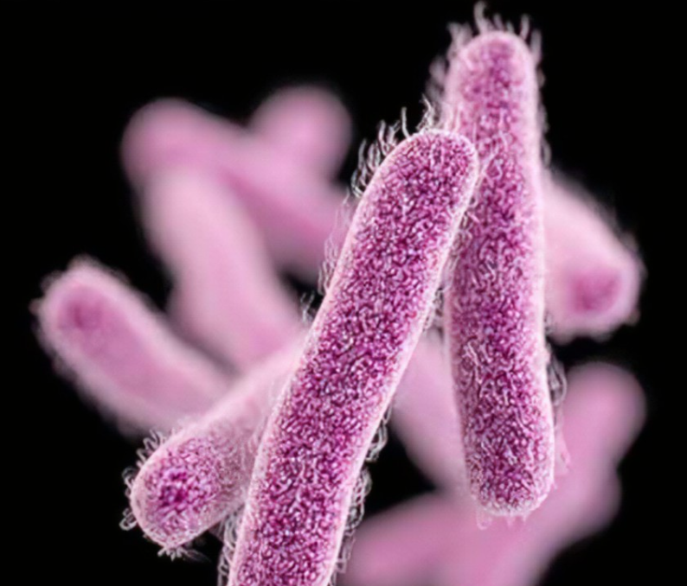
Multidrug-resistant organisms (MDRO)
How to prevent spread of MDROs
Follow
Follow Standard Precautions during all patient encounters
Implement
Implement Appropriate Precautions
Disinfect
Hands
Equipment

Slide 7
CAUTI Catheter associated urinary tract infection
CAUTI - CDC and NHSN definition: CAUTI is a surveillance definition defined as a symptomatic UTI where an indwelling urinary catheter was in place for more than two consecutive days in an inpatient ​
Patient must meet 1, 2, and 3 below:
Patient had an indwelling urinary catheter that had been in place for more than 2 consecutive days in an inpatient location on the date of event AND was either:
Present for any portion of the calendar day on the date of event, OR
Removed the day before the date of event
Patient has at least one of the following signs or symptoms:
fever (>38.0°C)
suprapubic tenderness
costovertebral angle pain or tenderness
urinary urgency
urinary frequency
dysuria
Patient has a urine culture with no more than two species of organisms identified, at least one of which is a bacterium of ≥ 100,000 CFU/ml.

Slide 8

Help Prevent CAUTI’s!!!
Enter orders for ALL indwelling foley catheters
Only insert for appropriate Indication
Utilize External Devices when possible
Utilize nurse Driven protocol
Duration (remove as soon as no longer medically indicated)

Slide 9
CLABSI Central line-associated bloodstream infection
CLABSI - CDC and NHSN definition: CLABSI is a surveillance definition defined as the recovery of a pathogen from a blood culture in a patient who had a central line present for a minimum of 2 days on the date of event or the day before. ​ ​ a single blood culture for an organism not commonly present on the skin (common commensal)​ ​ OR ​ two or more blood cultures for organism commonly present on the skin. ​ ​ The infection cannot be related to any other infection the patient might have ​ ​ AND​ must not have been present or incubating when the patient was admitted to the facility.

Slide 10
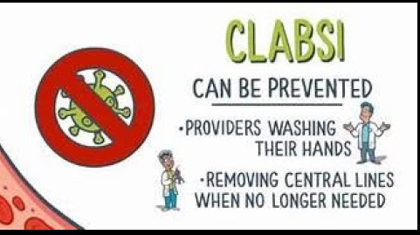
Help Prevent CLABSI!!!
Follow proper insertion techniques
Perform hand hygiene before insertion or manipulation
Adhere to aseptic technique
Choose best insertion site based on individual patient characteristics.
Avoid femoral sites
SC is preferred site
Use ultrasound guidance for insertion
Maintenance/Duration
Promptly remove lines when no longer medically necessary

Slide 11
SSI Surgical site infection
Superficial incisional Surgical Site Infection (SSI):Date of event occurs within 30 days following the NHSN operative procedure AND involves only skin and subcutaneous tissue of the incision AND patient has at least one of the following:
purulent drainage from the superficial incision.
organism(s) identified from an aseptically-obtained specimen from the superficial incision or subcutaneous tissue by a culture or nonculture based microbiologic testing method which is performed for purposes of clinical diagnosis or treatment
a superficial incision that is deliberately opened by a surgeon, physician or physician designee and culture or non-culture-based testing of the superficial incision or subcutaneous tissue is not performed AND patient has at least one of the following signs or symptoms: localized pain or tenderness; localized swelling; erythema; or heat.
diagnosis of a superficial incisional SSI by a physician or physician designee.
Deep incisional SSI: Date of event occurs within 30 or 90 days following the NHSN operative procedure AND involves deep soft tissues of the incision (for example, fascial and muscle layers) AND patient has at least one of the following:
purulent drainage from the deep incision.
a deep incision that is deliberately opened or aspirated by a surgeon, physician or physician designee or spontaneously dehisces AND organism(s) identified from the deep soft tissues of the incision by a culture or non-culture-based testing or culture-based testing is not performed AND patient has at least one of the following signs or symptoms: fever (>38°C); localized pain or tenderness.
an abscess or other evidence of infection involving the deep incision detected on gross anatomical exam, histopathologic exam, or imaging test.
Organ/Space SSI: Date of event occurs within 30 or 90 days following the NHSN operative procedure AND involves any part of the body deeper than the fascial/muscle layers that is opened or manipulated during the operative procedure AND patient has at least one of the following:
purulent drainage from a drain placed into the organ/space (for example, suction drainage system, open drain, T-tube drain, CT guided drainage).
organism(s) identified from fluid or tissue in the organ/space by a culture or non-culture based microbiologic testing method
an abscess or other evidence of infection involving the organ/space detected on gross anatomical exam or histopathologic exam, or imaging test evidence definitive or equivocal for infection.

Slide 12
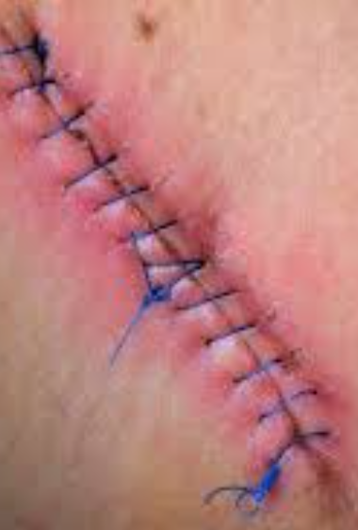
SSI Prevention
Preoperative Measures:
Intraoperative Measures:
Postoperative Measures:

Slide 13
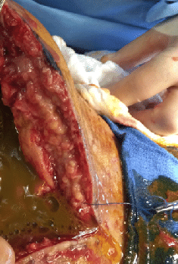
Surgical Site infections Present at Time of Surgery (PATOS)
Examples that indicate evidence of infection at time of surgery (PATOS)
Abscess
Infection
Purulence/pus
Phlegmon or “feculent peritonitis”
**Must be documented in the narrative portion of the operative report by the surgeon**

Slide 14
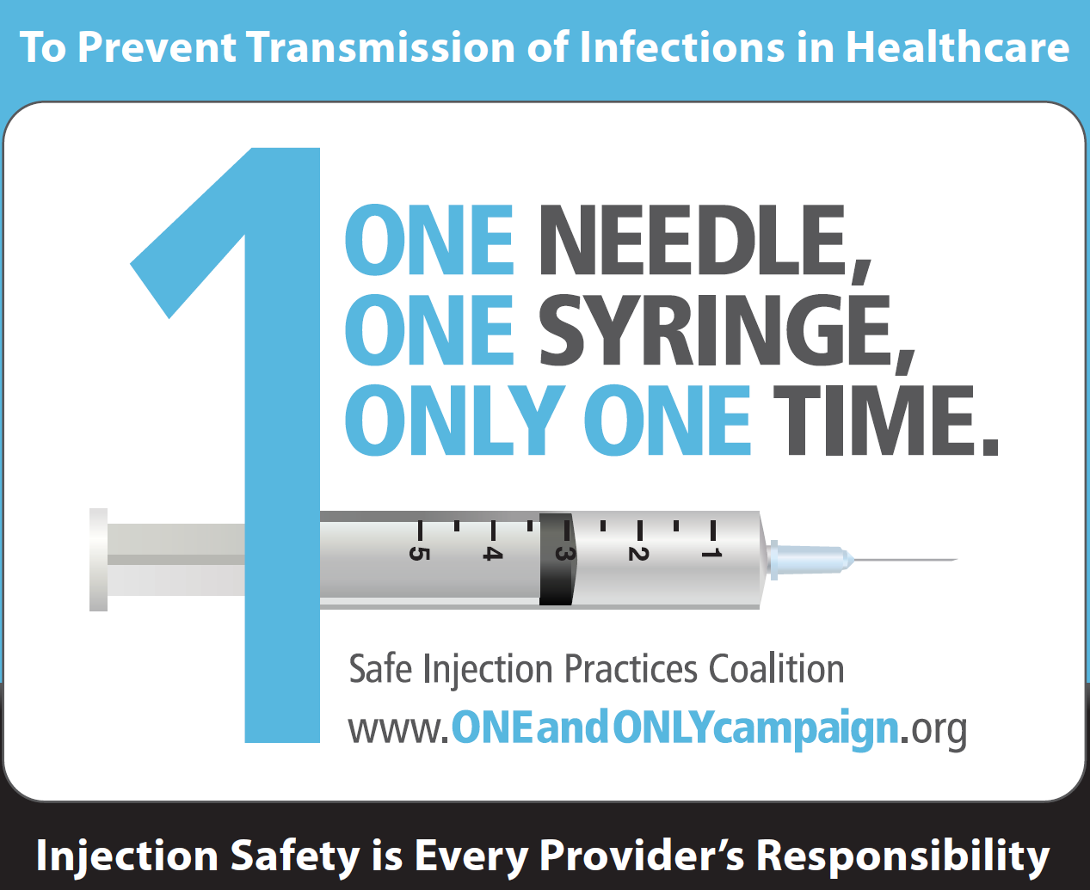
INJECTION SAFETY

Slide 15

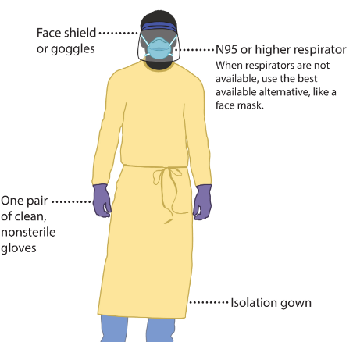
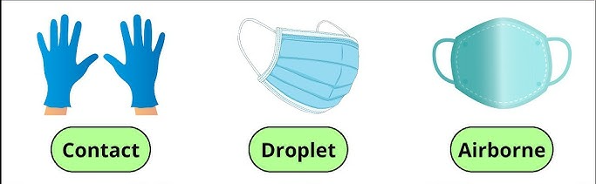
Follow Proper Isolation Precautions & wear appropriate PPE

Slide 16

Standard Precautions
Standard Precautions are infection prevention practices used to avoid the transmission of infectious agents.
Used with all patients regardless of known or suspected infection status.
Assume all patients or body fluids may be infectious
Wear gloves when anticipated contact with patient’s blood or body fluids, mucus membranes, non-intact skin, or insertion point of a patient’s invasive or indwelling devices (central lines, urinary foley catheters, ventilators)
ALWAYS perform hand hygiene before and after all patient encounters.
GLOVE USE IS NOT A SUBSTITUTE FOR HAND HYGIENE!

Slide 17
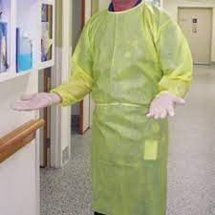

Contact Precautions:
In addition to Standard Precautions, use Contact Precautions in the care of patients known or suspected to have an illness easily transmitted by direct patient contact or by indirect contact with items in the patient’s environment.
Gloves
Wear gloves when touching the patient and the patient’s immediate environment or belongings
Remove gloves promptly after use and discard before touching non-contaminated items or environmental surfaces, and before providing care to another patient
Wash hands immediately after removing gloves
Gowns
Wear a fluid resistant, non-sterile gown if contact with the patient or their environment is anticipated
Do not wear the same gown for the care of more than one patient
Examples Contact Isolation patients:
MDRO’s (MRSA, VRE, ESBL, CRE)
Draining wounds
Scabies, Lice, Bed Bugs

Slide 18
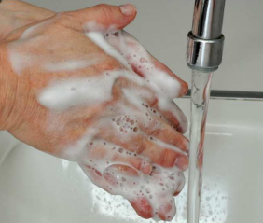

Special Enteric: (Indirect transmission)
Use Special Enteric Precautions in the care of patients known or suspected to have an illness easily transmitted by direct patient contact or by indirect contact with items in the patient’s environment for infections that are not commonly killed by routine disinfectants
Gloves
Wear gloves when touching the patient and the patient’s immediate environment or belongings
Remove gloves promptly after use and discard before touching non-contaminated items or environmental surfaces,
Wash hands immediately after removing gloves
Gowns
Wear a fluid resistant, non-sterile gown if contact with the patient or their environment is anticipated
Do not wear the same gown for the care of more than one patient
Disinfect all equipment with bleach
Wash hands with soap and water
Examples of Special Isolation Patients:
Clostridium difficile (C-diff)
Norovirus
Acute Diarrhea

Slide 19
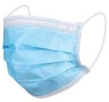

Droplet Precautions: Droplet Precautions are required to protect against droplet transmission of infectious agents. Droplets can be generated from a person during coughing, sneezing, talking or during the performance of certain procedures such as suctioning or bronchoscopy.
Droplets generally travel no more than 3 feet from the patient. These droplets can be deposited on the host’s nasal mucosa, conjunctivae or mouth.
Mask:
Wear a facemask, such as a procedure or surgical mask, for close contact with the patient; the facemask should be donned upon entering the exam room
Wear eye protection
Examples of Droplet isolation patients:
Influenza (Flu A/Flu B)
Bacterial Meningitis
Strep Throat
Pertussis/RSV

Slide 20
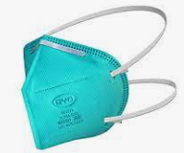
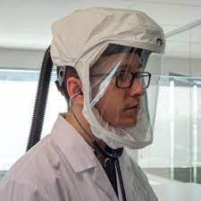
Airborne Transmission: Airborne precautions are required to protect against airborne transmission of infectious agents. Aerosols usually enter through the respiratory tract. These aerosols have the ability to remain suspended in the air for long periods of time and travel long distances.
Wear an N95 Respirator
Prior fit-testing that must be repeated annually and fit-check / seal-check prior to each use. OR Powered Air-Purifying Respirator (PAPR)
The respirator should be donned prior to room entry and removed after exiting room
OR
Examples of Airborne / Respiratory Isolation patients:
Mycobacterium Tuberculosis (TB)
Shingles/Chickenpox
Avian Flu
Measles
Small pox

Slide 21
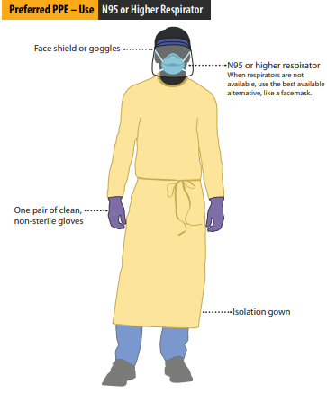
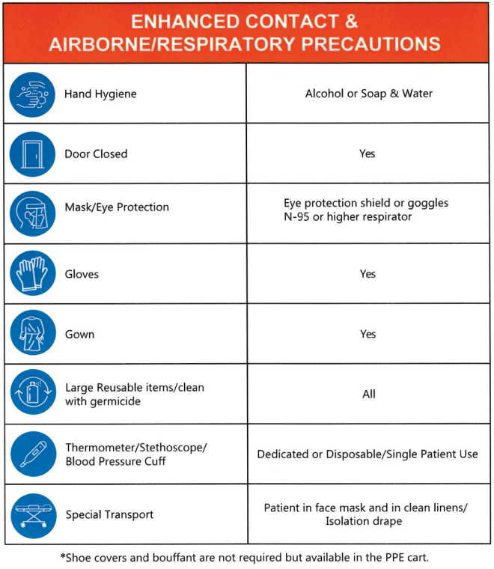
Airborne & Contact Precautions: Airborne precautions are required to protect against airborne transmission of infectious agents. Aerosols usually enter through the respiratory tract. These aerosols have the ability to remain suspended in the air for long periods of time and travel long distances. These infection can also be transmitted by by direct patient contact or by indirect contact with items in the patient’s environment.
Wear an N95 Respirator Prior fit-testing that must be repeated annually and fit-check / seal-check prior to each use. OR Powered Air-Purifying Respirator (PAPR)
The respirator should be donned prior to room entry and removed after exiting room
Examples of Enhanced Contact & Airborne / Respiratory Isolation patients:
COVID – 19

Slide 22
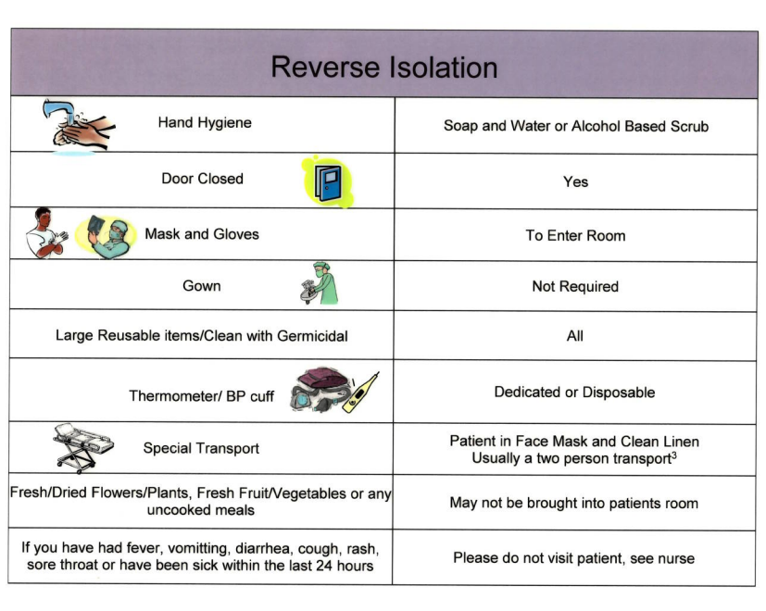
Reverse Isolation:
Use Special Reverse Isolation Precautions in the care of patients. We are the danger to these patients. Patients with severely weakened immune system.
Gloves
Wash hands before donning gloves
Wear gloves when touching the patient and the patient’s immediate environment or belongings
Remove gloves promptly after use and discard before touching non-contaminated items or environmental surfaces, and before providing care to another patient
Wash hands immediately after removing gloves
Mask
Wear a face mask when coming in contact with patient or their environment to protect the patient.
Examples of Special Isolation Patients:
Chemotherapy
HIV
Low WBC’s
Severely immunocompromised patients

Slide 23
IP Committees
Infection Prevention Committee
Quarterly (2nd Wed. of the month @ 12pm February, May, August, & November)
CAUTI/CLABSI Committee
Meets quarterly & as needed
SSI Committee
Meets monthly & as needed
Hand Hygiene Committee
Quarterly & as needed

Slide 24
Thank You!
IP Contact Information
Brenda Dalrymple, Infection Prevention Officer
bdalrymple@echd.org
Ext. 1466
Monica Martinez, Infection Prevention Coordinator
mmartinez4@.org
Ext. 1463
Ashley Boldus, Infection Prevention Coordinator
aboldus@echd.org
Ext. 1460

Slide 25
References
Agency for Healthcare Research and Quality (AHRQ). Guidelines to Prevent Central Line associated Blood Stream Infections. https://www.ahrq.gov/hai/clabsi-tools/appendix-3.html
Centers for Disease and Control and Prevention (CDC). Handwashing: Clean Hands Save Lives https://www.cdc.gov/handwashing/index.html (2020).
CDC. https://www.cdc.gov/infectioncontrol/pdf/guidelines/cauti-guidelines-H.pdf
CDC. https://www.cdc.gov/infectioncontrol/pdf/guidelines/cauti-guidelines-H.pdf
CDC. Isolation Precautions. https://www.cdc.gov/infectioncontrol/guidelines/isolation/index.html
NHSN: https://www.cdc.gov/nhsn/training/patient-safety-component/index.html
World Health Organization. Save lives clean your hands. Retrieved from https://www.who.int/campaigns/world-hand-hygiene-day
World Health Organization. 2010. The burden of health care associated infection worldwide. Retrieved from https://www.who.int/news-room/feature-stories/detail/the-burden-of-health-care-associated-infection-worldwide

Slide 26
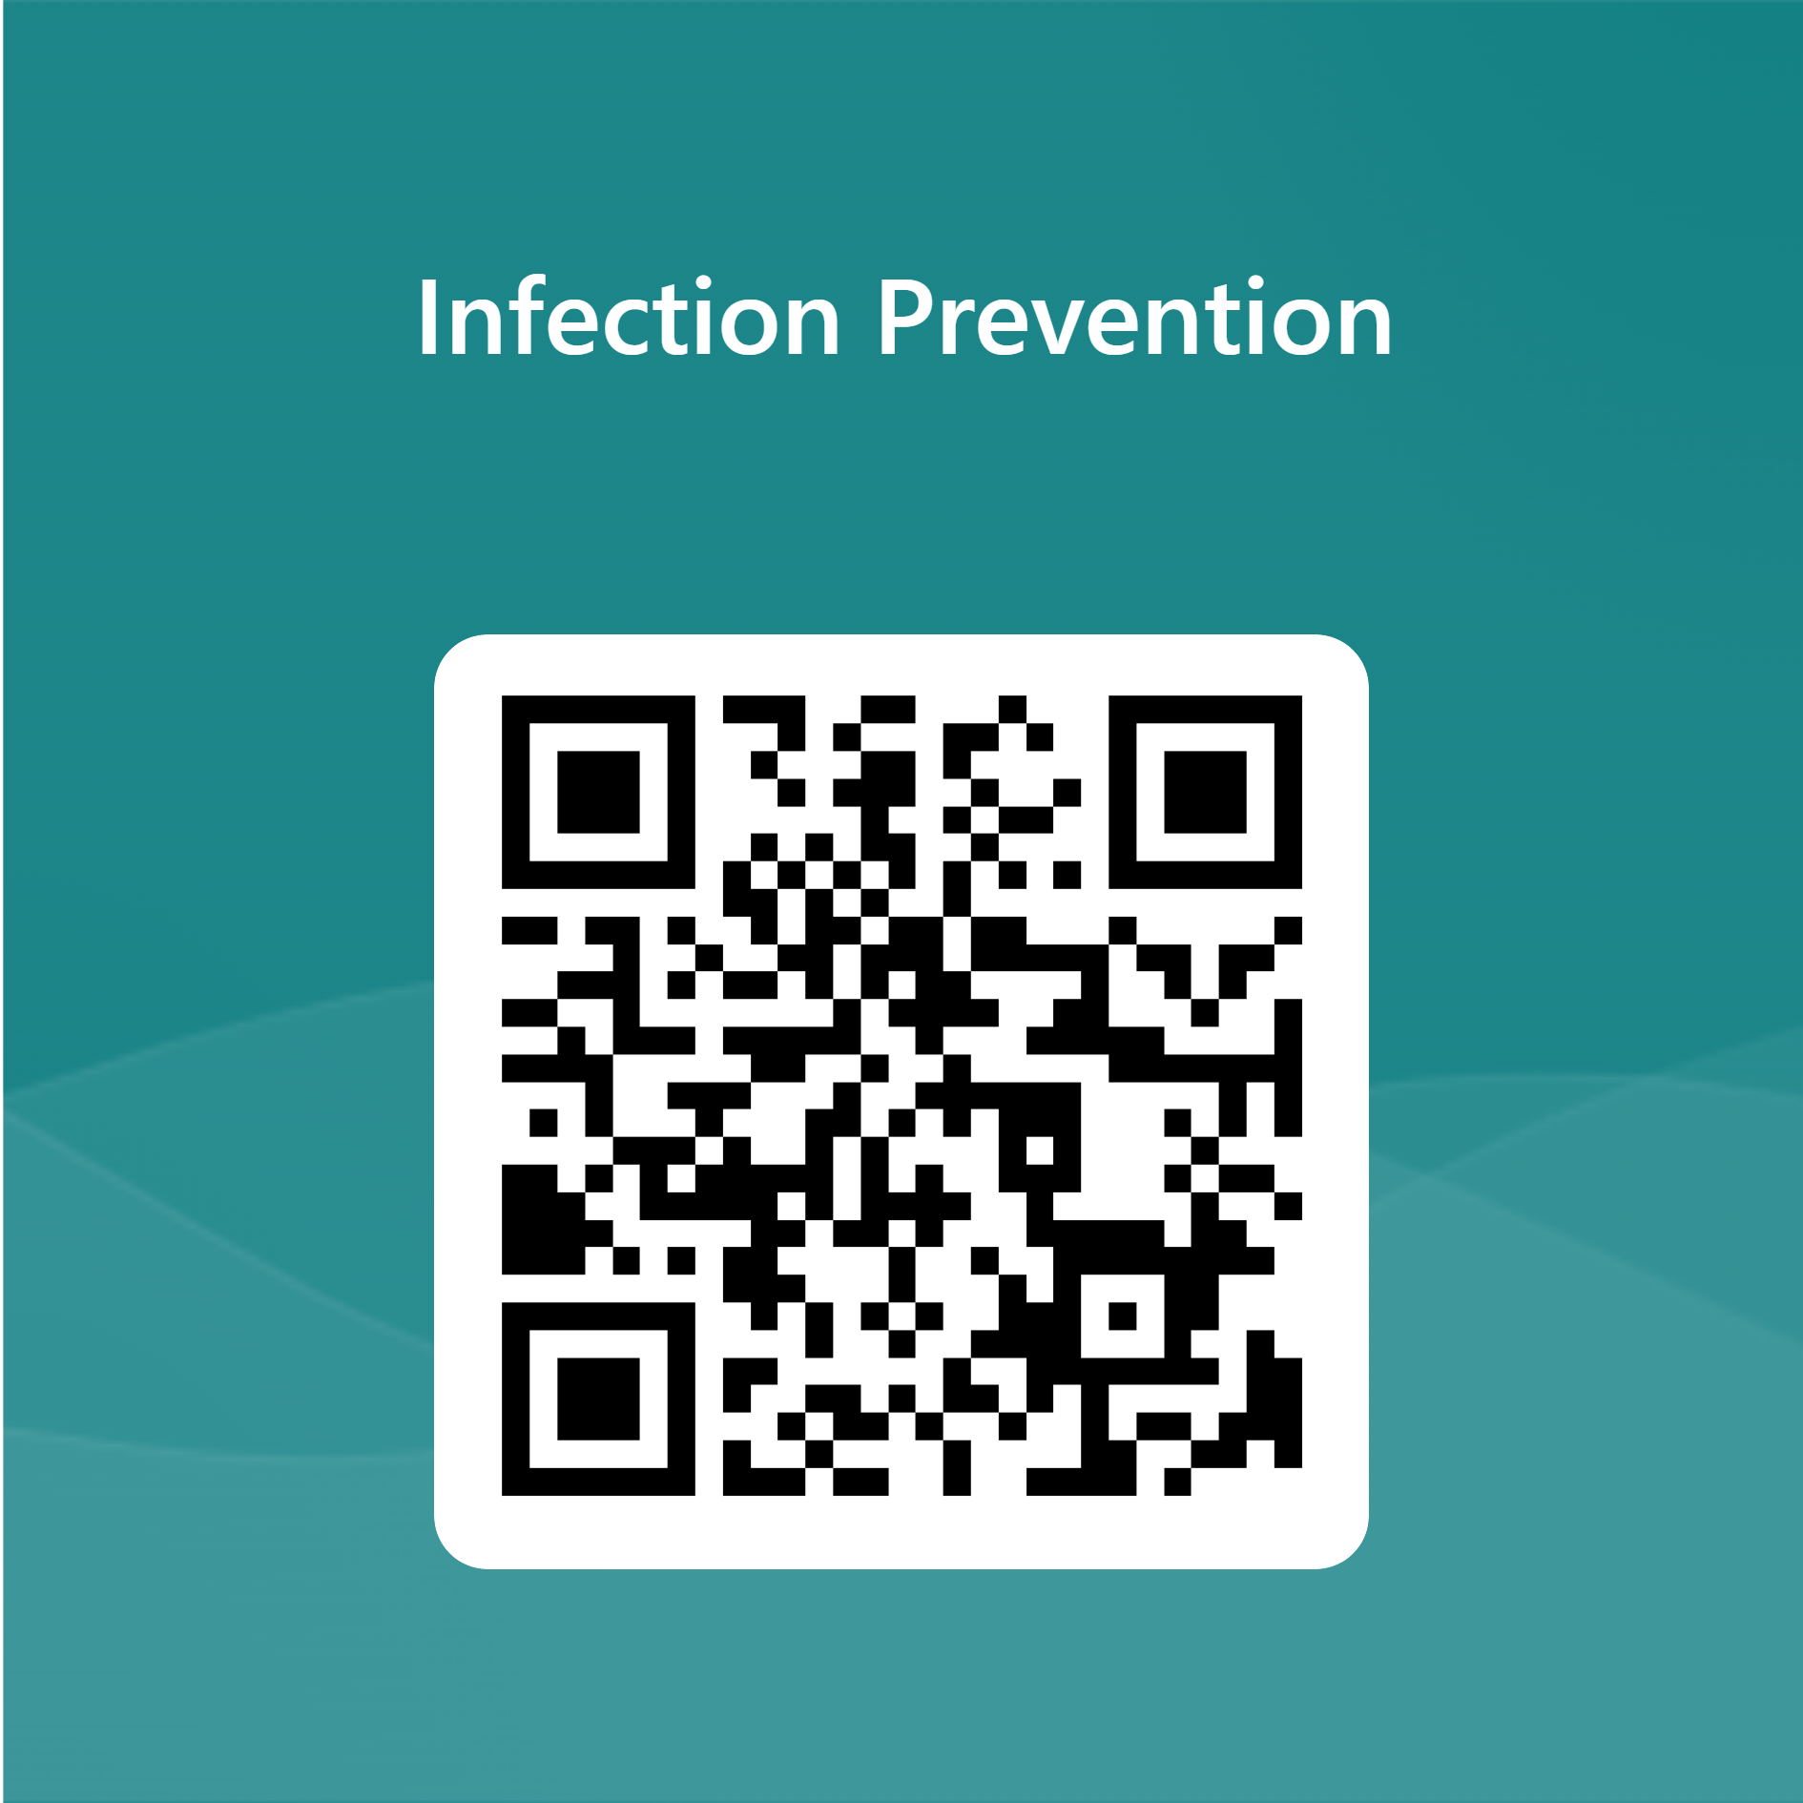
Continue to Test
Link
https://forms.office.com/r/byyLZhSusg

